Slide 1
Webdevelopment – Kickoff 2024 - 2025

Slide 2
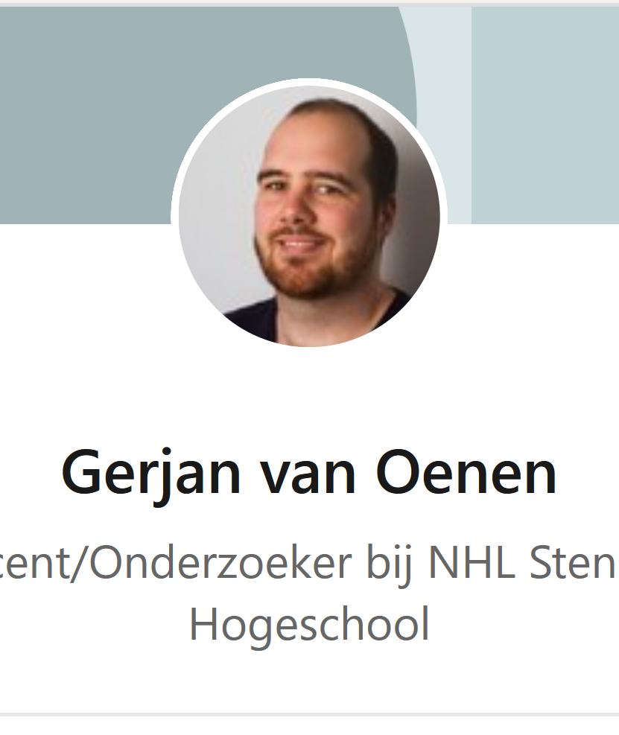
Introducing
Gerjan van Oenen
17th of September 1990
Born and raised in Emmen
University of Groningen
Stenden University of Applied Sciences
Bachelor of Science
Videogames, football (soccer), anime, quizzes and cooking

Slide 3

Why Webdevelopment?

Slide 4

Een aantal redenen…
Deze foto van Onbekende auteur is gelicentieerd onder CC BY-NC-ND

Slide 5

Interesting Learning Curve

Slide 6

Immediate results

Slide 7

Structure

Slide 8
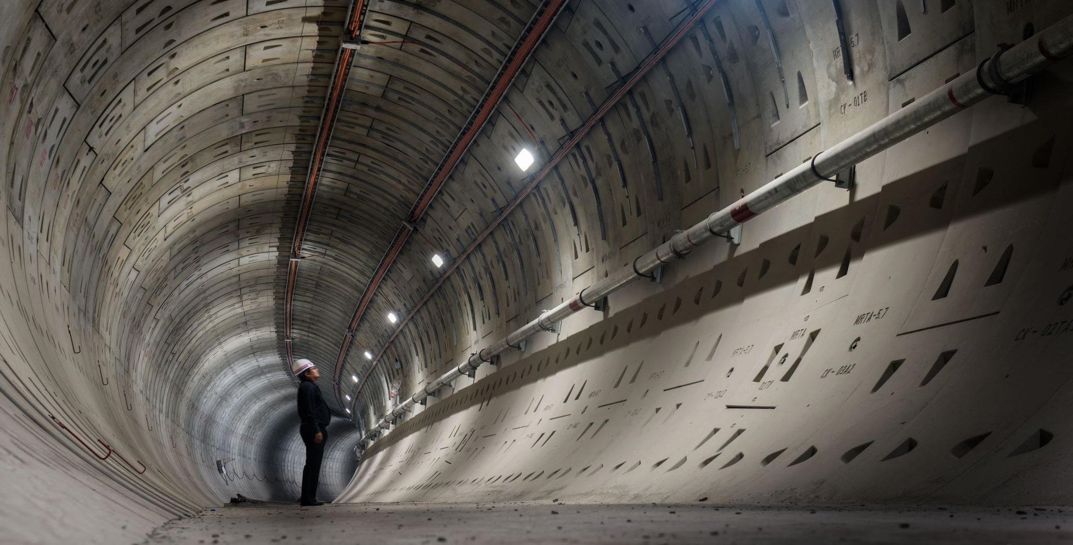
How will we be working?

Slide 9

Modulebook

Slide 10
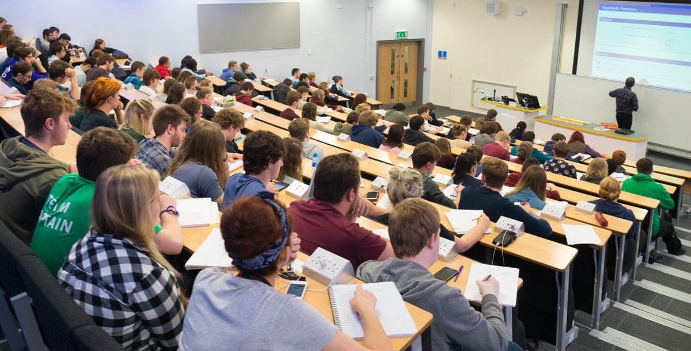
Classes

Slide 11
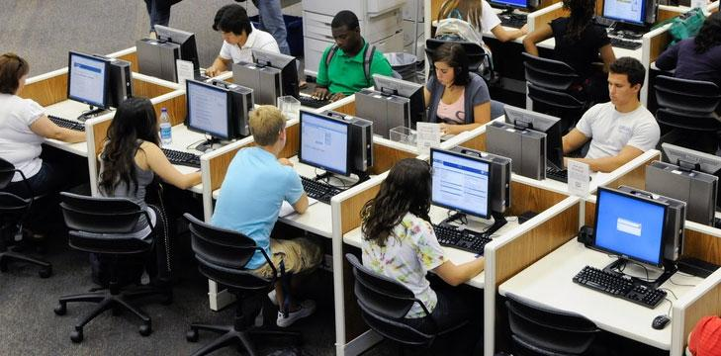
Examination

Slide 12
Questions?

Slide 13
Tasks
Download:
Visual Studio Code
Docker
MS Office(?)

Slide 14

Blackboard Sign-up

